Slide 1

HR Data Analysis
Goutham Kumar Aare
Data Analyst

Slide 2
Objectives
Create Dashboard using Power BI
Data Cleaning
Pivot Table
Conditional Formatting
Filtering Data
Excel Charts
DAX
Star Schema

Slide 3
Key Insights
Count of Employee: 4410
Average of Monthly Income: 65.03K
Average of Standard Hour: 08
Average of Performance Rating: 3.15
Average of Age: 36.92

Slide 4
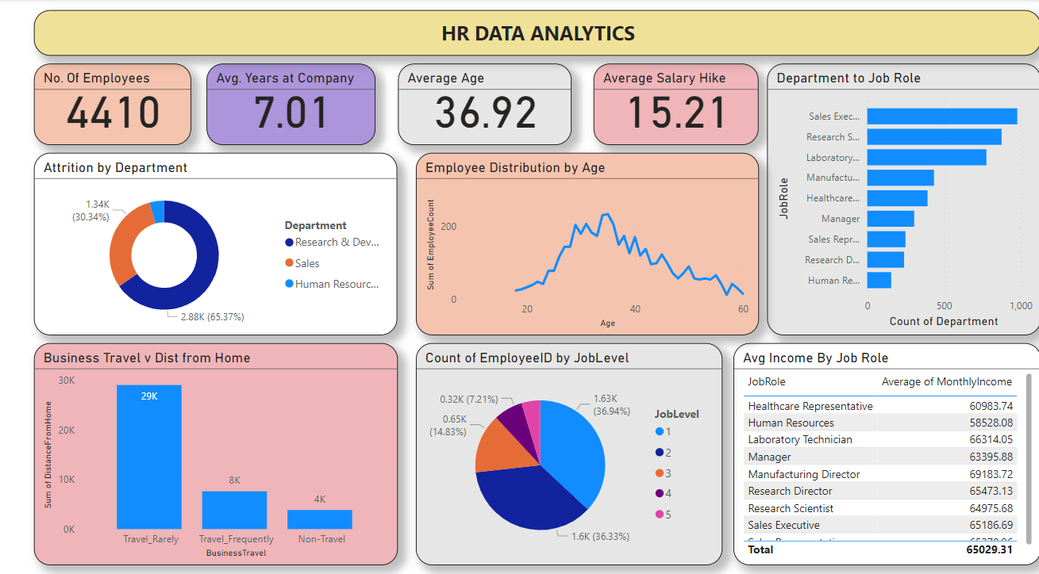
HR Data Analysis Dashboard

Slide 5
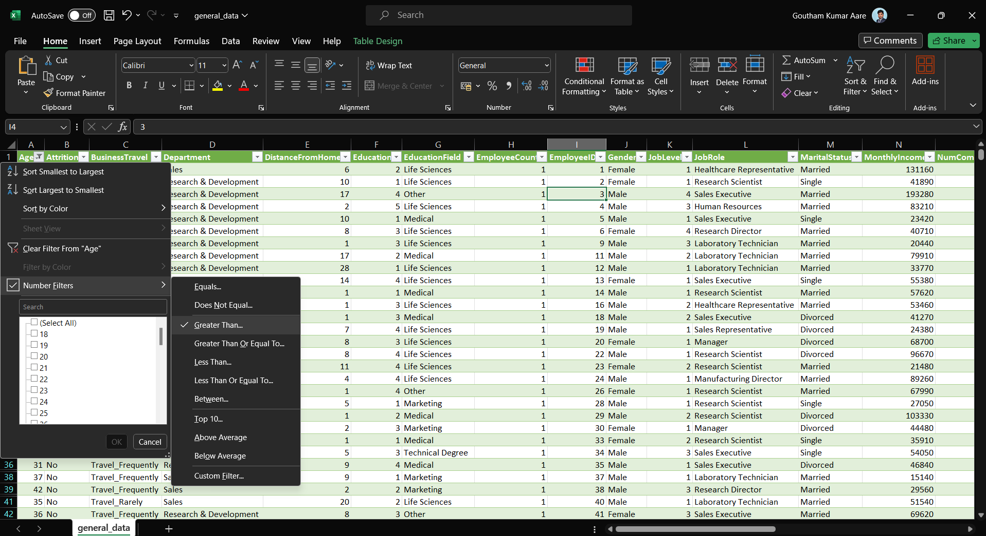
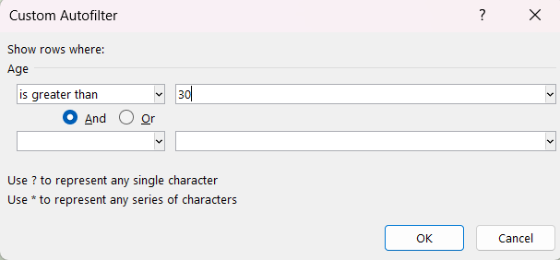
1. Using Excel, how would you filter the dataset to only show employees aged 30 and above?

Slide 6
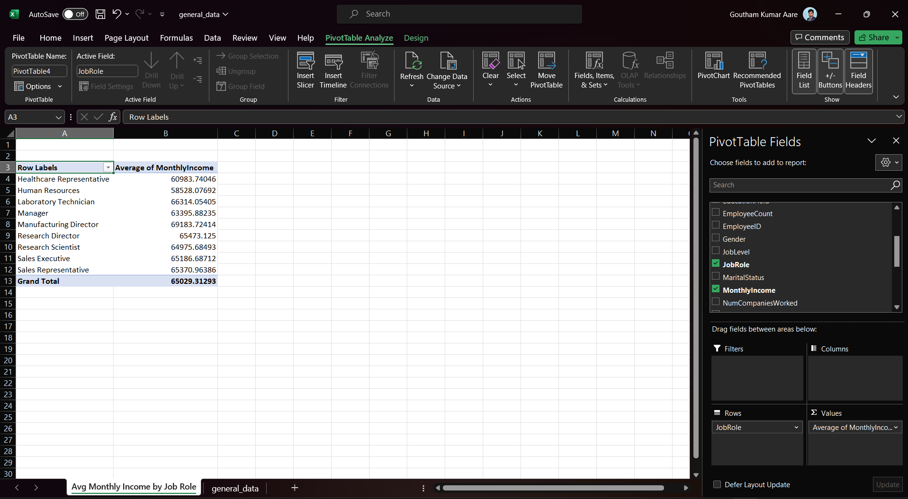
2. Create a pivot table to summarize the average Monthly Income by Job Role.

Slide 7
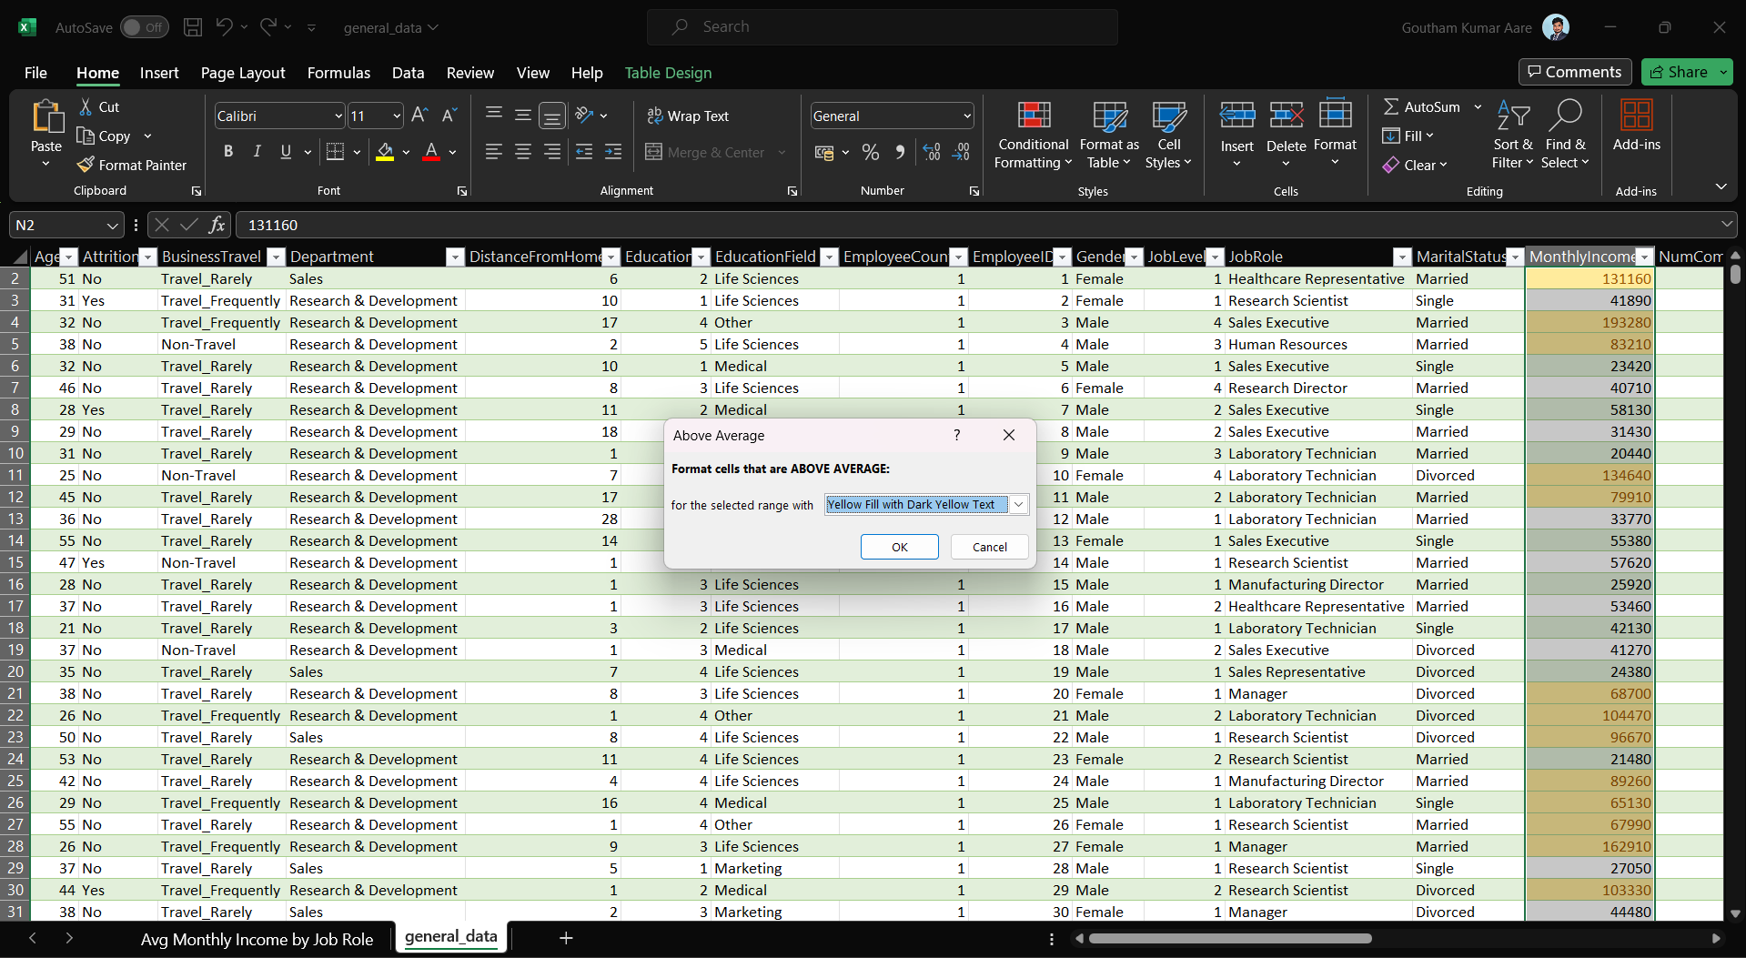
3. Apply conditional formatting to highlight employees with Monthly Income above the company's average income.

Slide 8
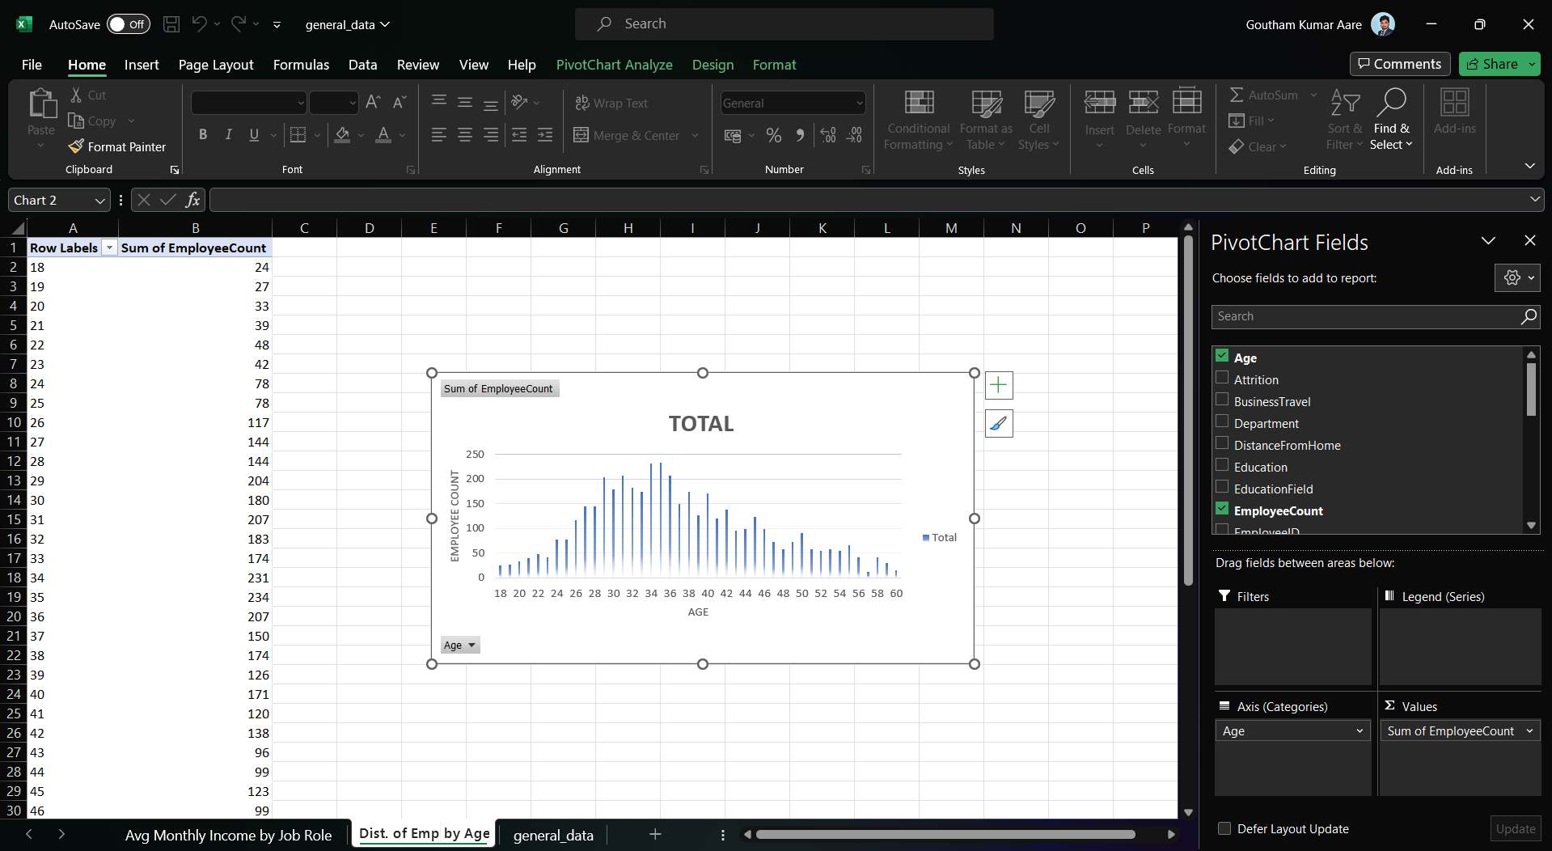
4. Create a bar chart in Excel to visualize the distribution of employee age

Slide 9
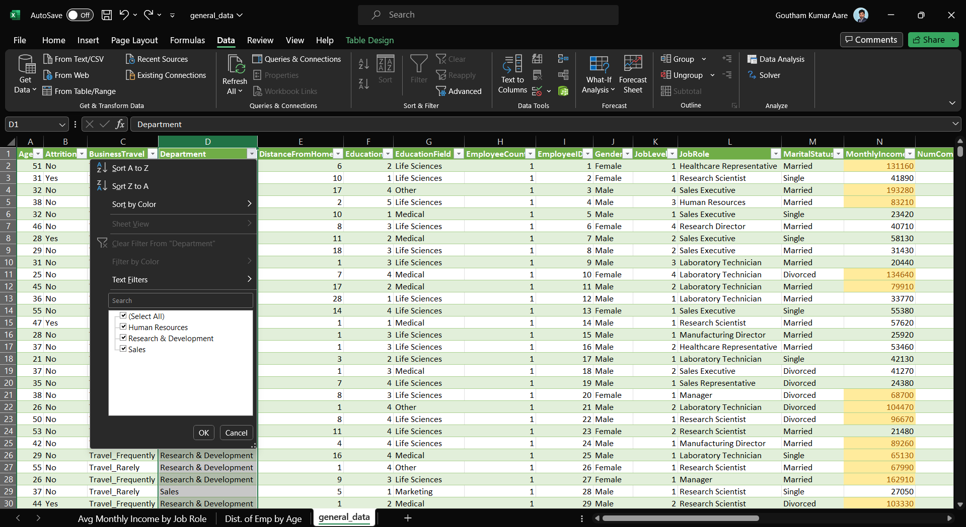
5. Identify and clean any missing or inconsistent data in the "Department" column.
No missing Data
Found

Slide 10
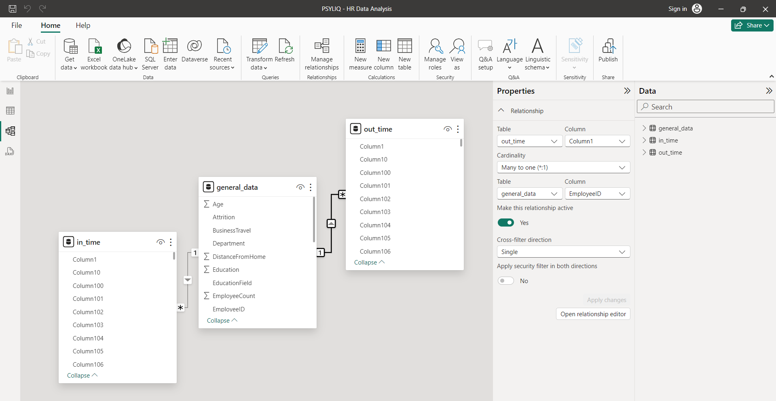
6. In Power BI, establish a relationship between the "EmployeeID" in the employee data and the "EmployeeID" in the time tracking data.

Slide 11
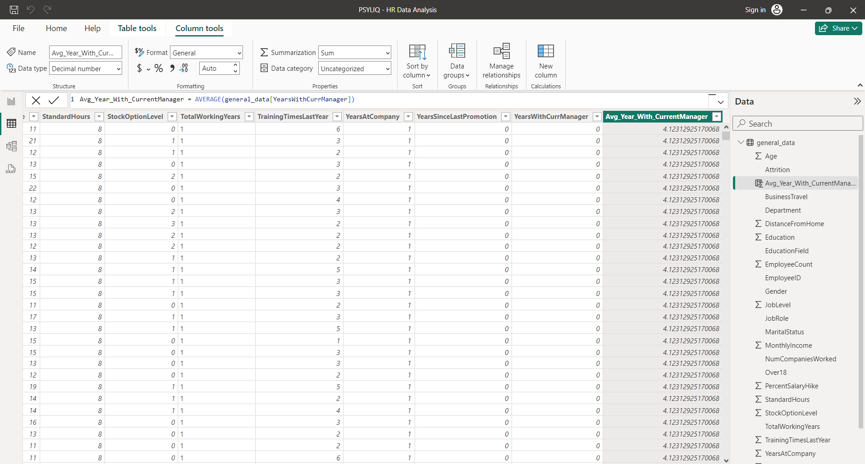
7. Using DAX, create a calculated column that calculates the average years an employee has spent with their current manager.

Slide 12
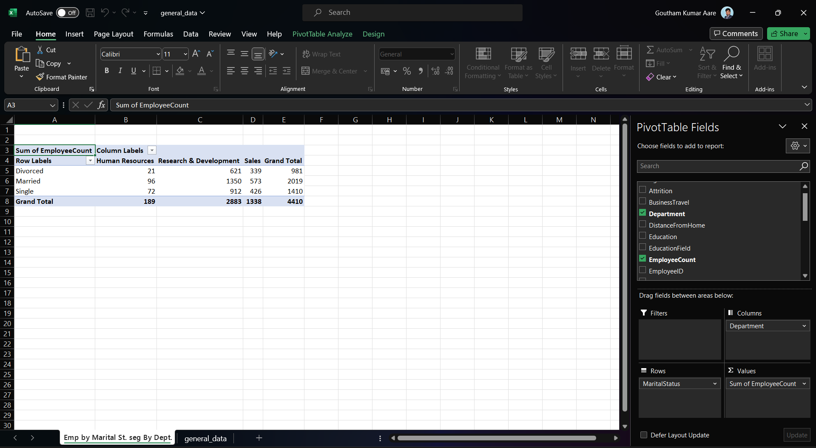
8. Using Excel, create a pivot table that displays the count of employees in each Marital Status category, segmented by Department.

Slide 13
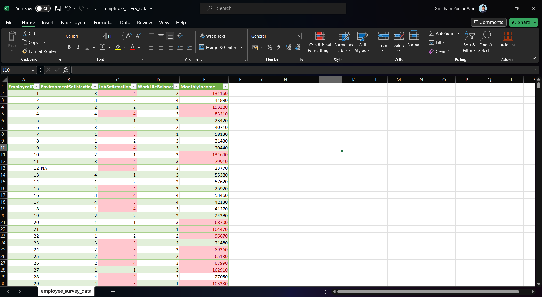
9. Apply conditional formatting to highlight employees with both above-average Monthly Income and above-average Job Satisfaction.

Slide 14
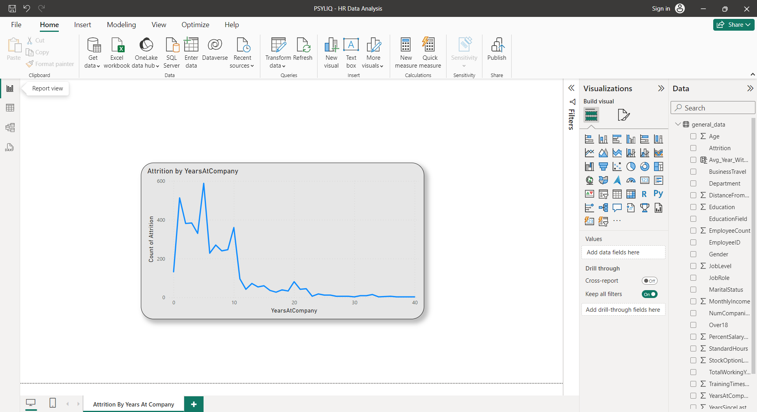
10.In Power BI, create a line chart that visualizes the trend of Employee Attrition over the years.

Slide 15
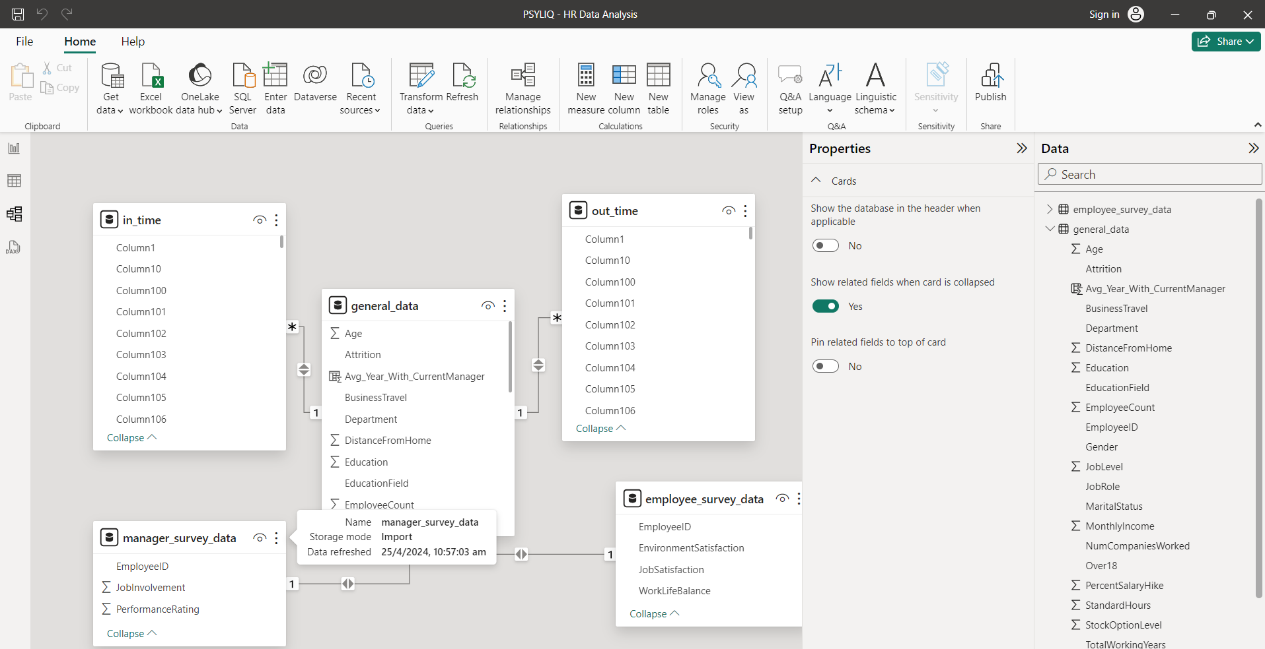
11. Describe how you would create a star schema for this dataset, explaining the benefits of doing so.

Slide 16
Benefits of Star Schema
Simplified structure
Query Performance Improvement
Scalability
Enhanced Aggregation Capabilities
Easier Maintenance
Query Optimization

Slide 17
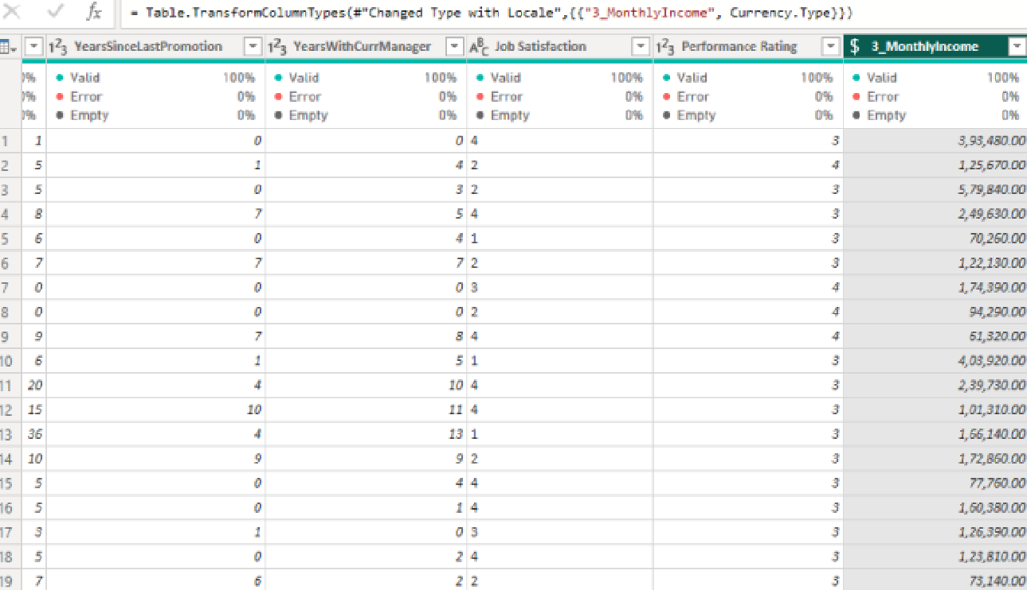
12. Using DAX, calculate the rolling 3-month average of Monthly Income for each employee.

Slide 18
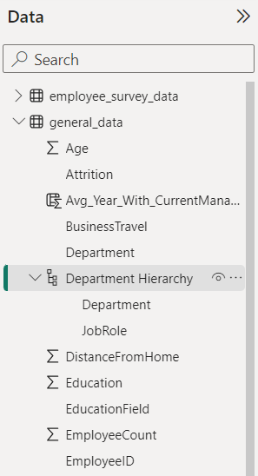
13. Create a hierarchy in Power BI that allows users to drill down from Department to Job Role to further narrow their analysis.

Slide 19
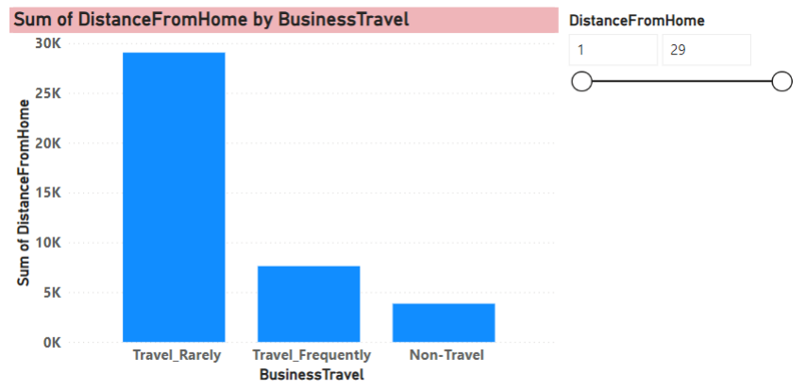
14. How can you set up parameterized queries in Power BI to allow users to filter data based on the Distance from Home column?

Slide 20
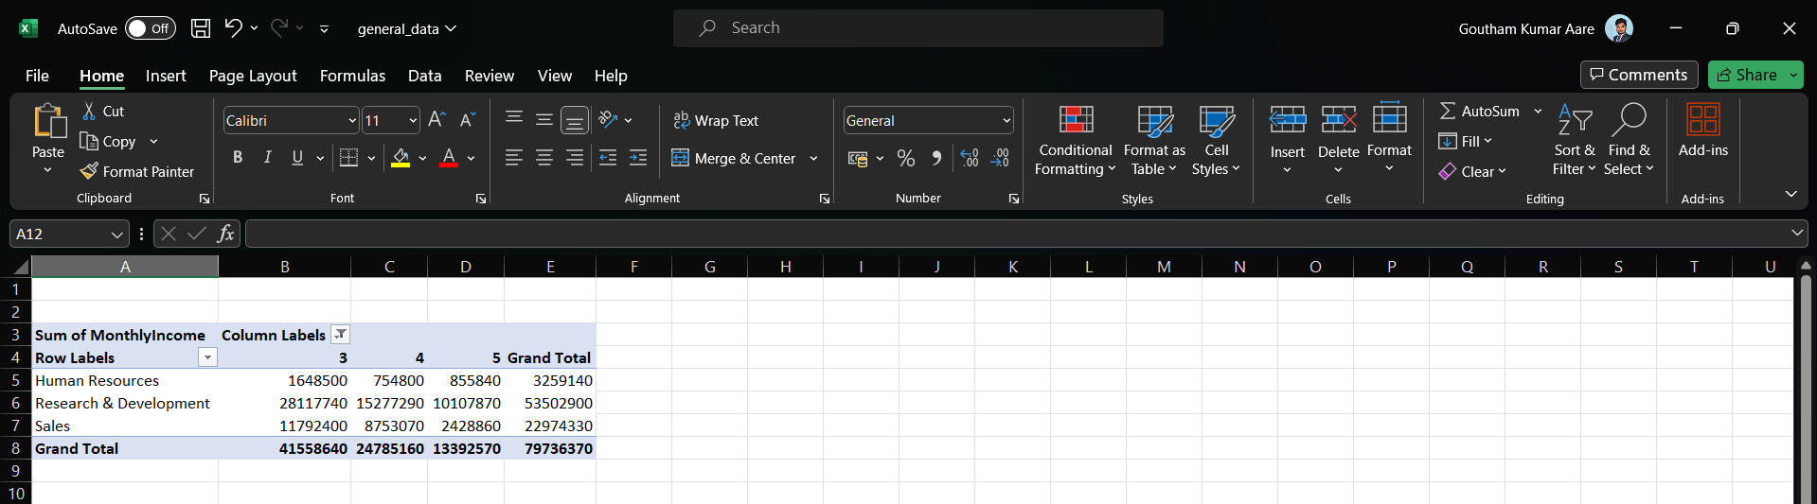
15. In Excel, calculate the total Monthly Income for each Department, considering only the employees with a Job Level greater than or equal to 3.

Slide 21
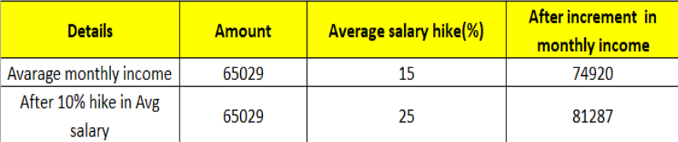
16. Explain how to perform a What-If analysis in Excel to understand the impact of a 10% increase in Percent Salary Hike on Monthly Income.

Slide 22
17. Verify if the data adheres to a predefined schema. What actions would you take if you find inconsistencies?
Data Cleaning
Data Transformation
Adding Calculated Columns
Building Relationships
Proper Documentation

Slide 23
Thank You
Got Questions….?
Reach me out at
www.linkedin.com/in/gou8m

